Slide 1
Quick Wins or great losses; preventing and preparing for incident response

Slide 2

IT for 11 years
InfoSec for 7 years (Gov and Private)
3 years at an international IR consultancy
Worked 43 discrete incident response engagements while consulting
Luke Pearson

Slide 3
disclaimer
Case studies and examples are drawn from my experiences and activities working for a variety of customers and employers, and do not represent my work for any one customer, set of customers or particular employer. In many cases, facts have been changed to obscure the identity of my customers and individuals associated with my customers.

Slide 4

The Secrets group
Charged with keeping secrets
Recent security breach
What can we learn?

Slide 5
Initial access
Credential stuffing
No Bueno?
Phishing email!

Slide 6


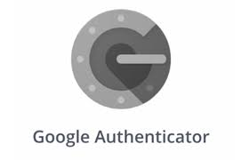


Two factor authentication
Cloud services
External facing services
Admin account access
Critical services

Slide 7

Disable macros
Just disable them
No really, you don’t need them

Slide 8
Workstation Lateral Movement
Privilege escalation
Local administrator
Group policy?!

Slide 9
Workstation hardening
Unique Passwords for local admin accounts
Not via GPO
Disable remote logon
Enable host based firewall

Slide 10
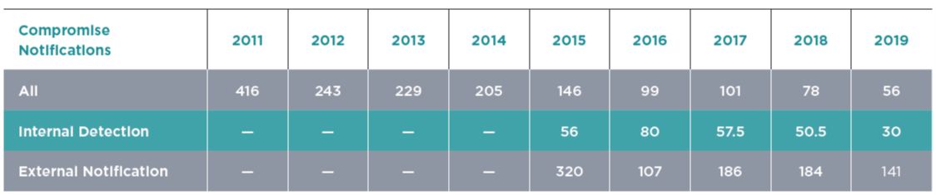
Logging – Dwell Time

Slide 11

Logging - Retention
Logs don’t need a siem to be useful
Client:Server compromise ratio 4:1
Windows defaults to 20mb event log max size

Slide 12
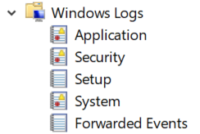
Logging - Verbosity
It’s not just this

Slide 13
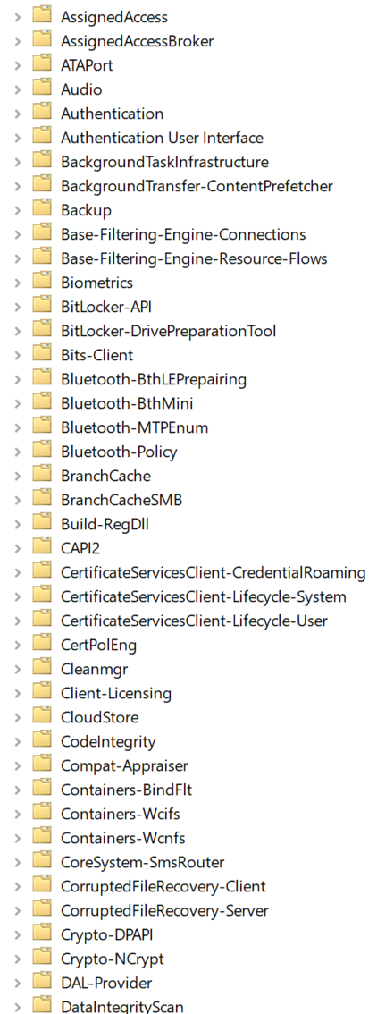
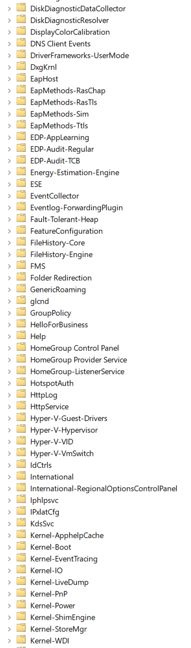
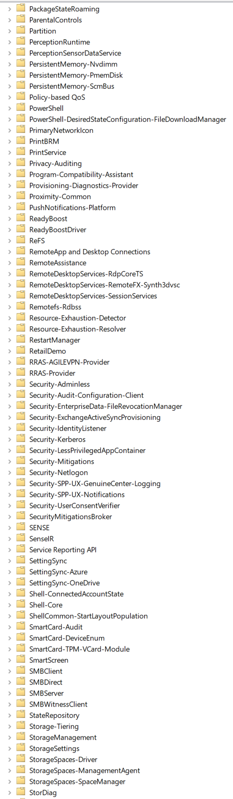
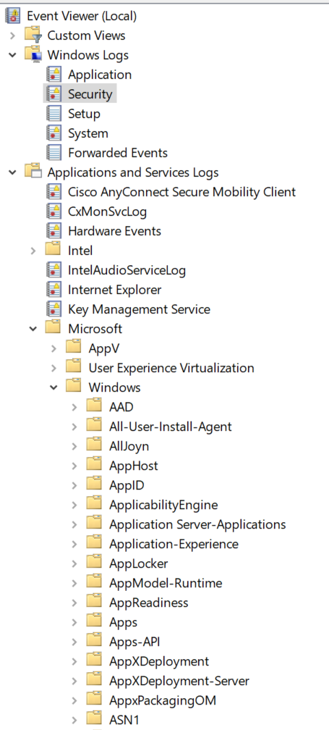
Logging - Verbosity
We have options!

Slide 14
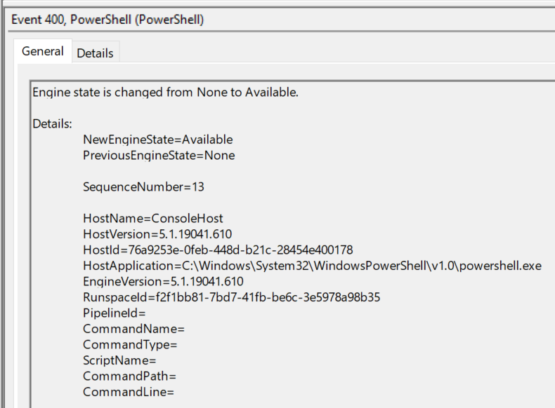
Logging - Verbosity
And we can do better than this

Slide 15
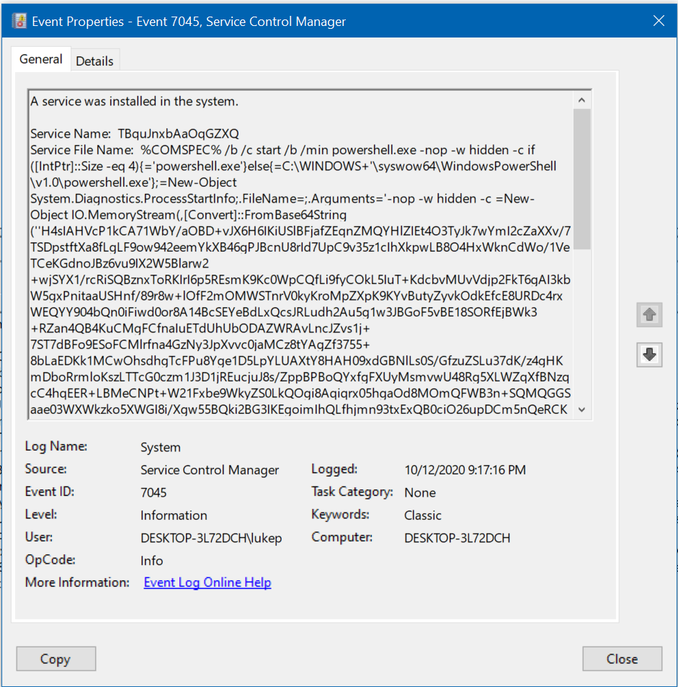
Logging – Service installation
Looks suspicious to me

Slide 16
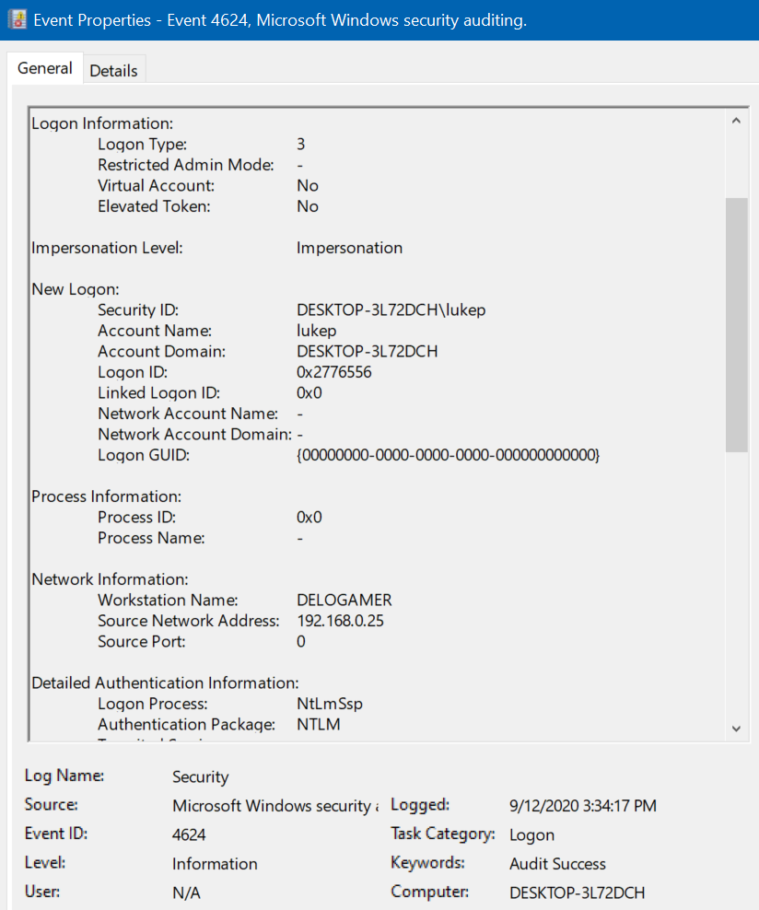
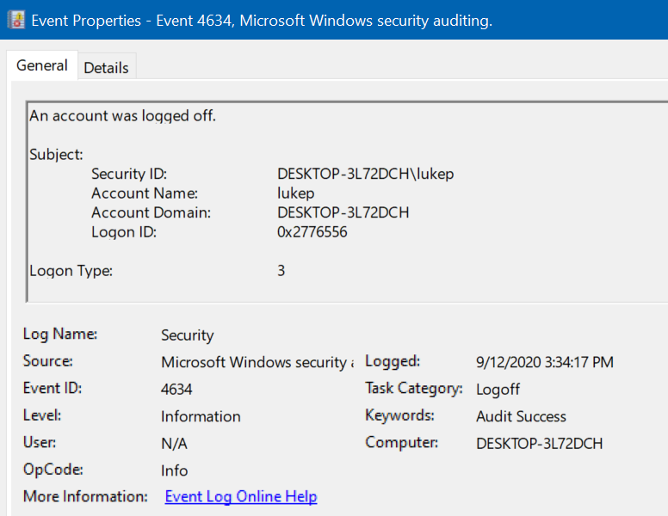
Logging - Authentication
Service has been installed
Timelining and logs!
User account logs in
Bad event takes place
User account logs out

Slide 17
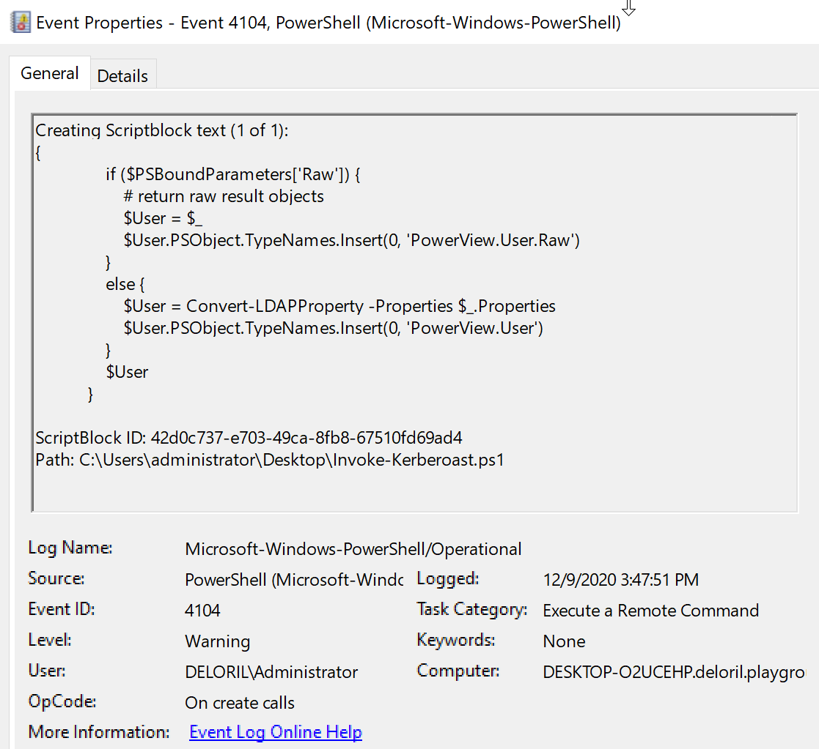
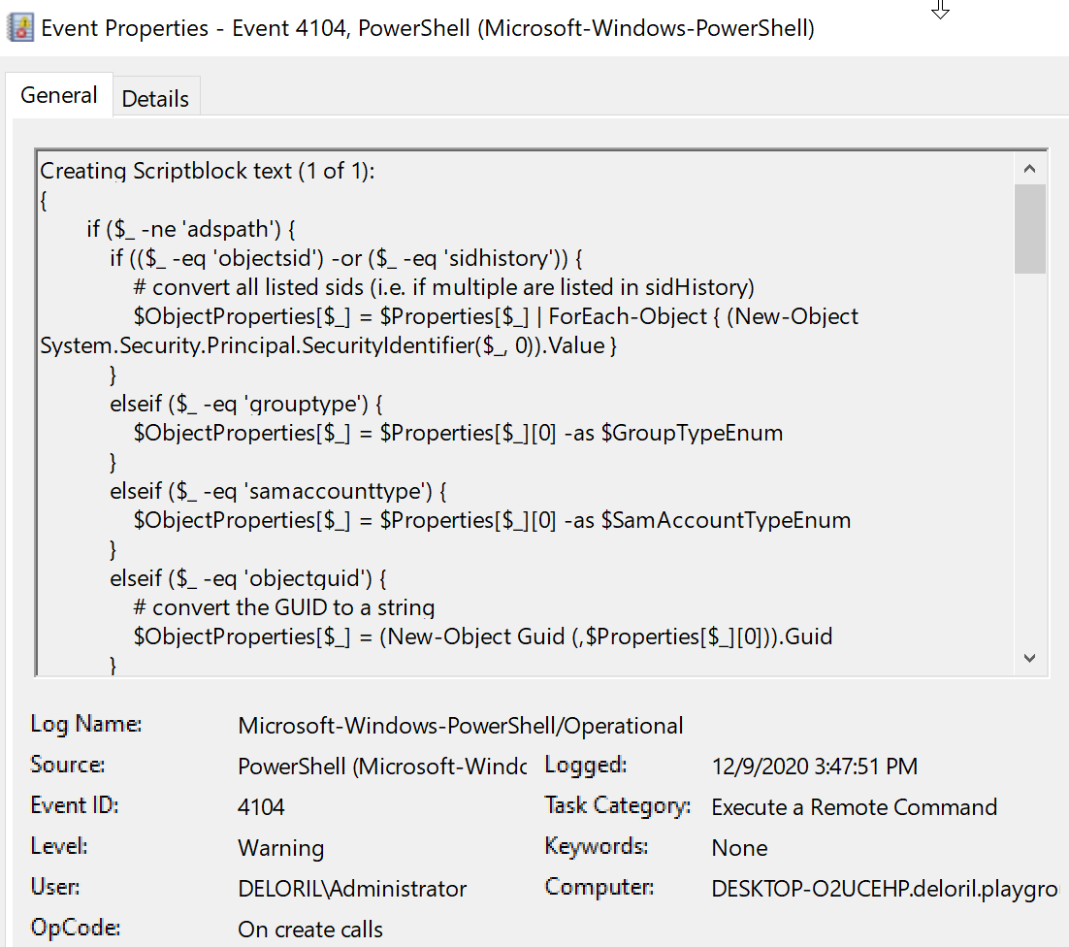
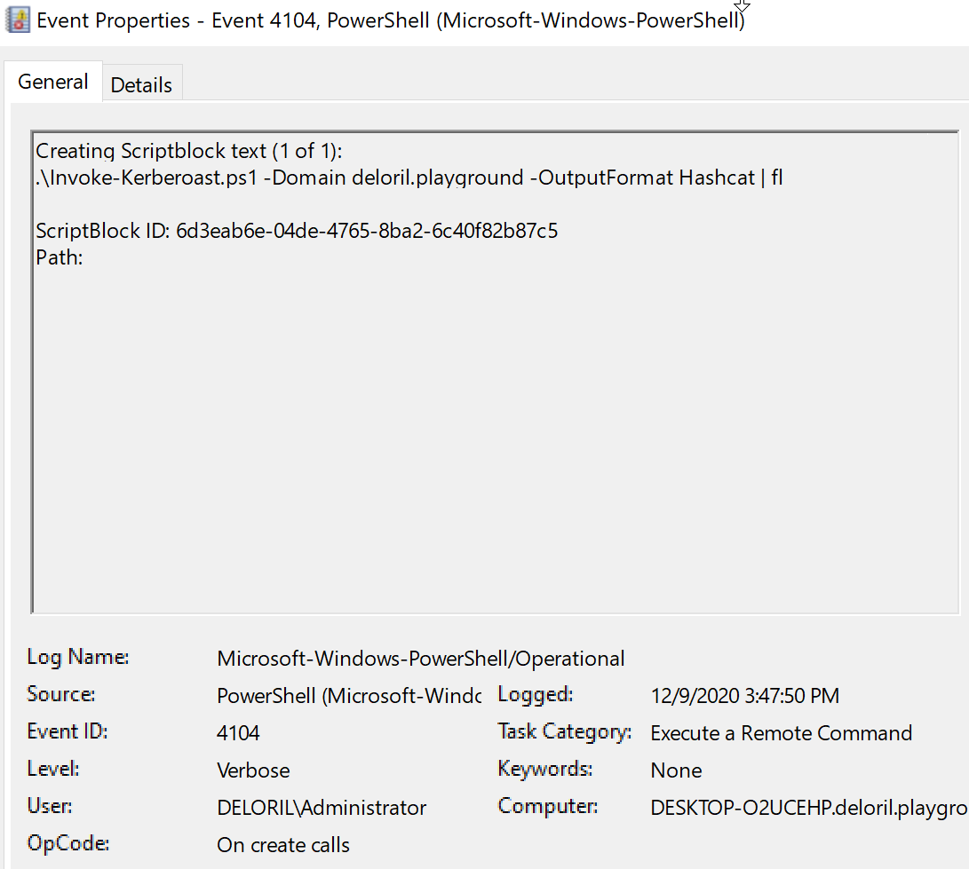
Logging – powershell:: script block

Slide 18
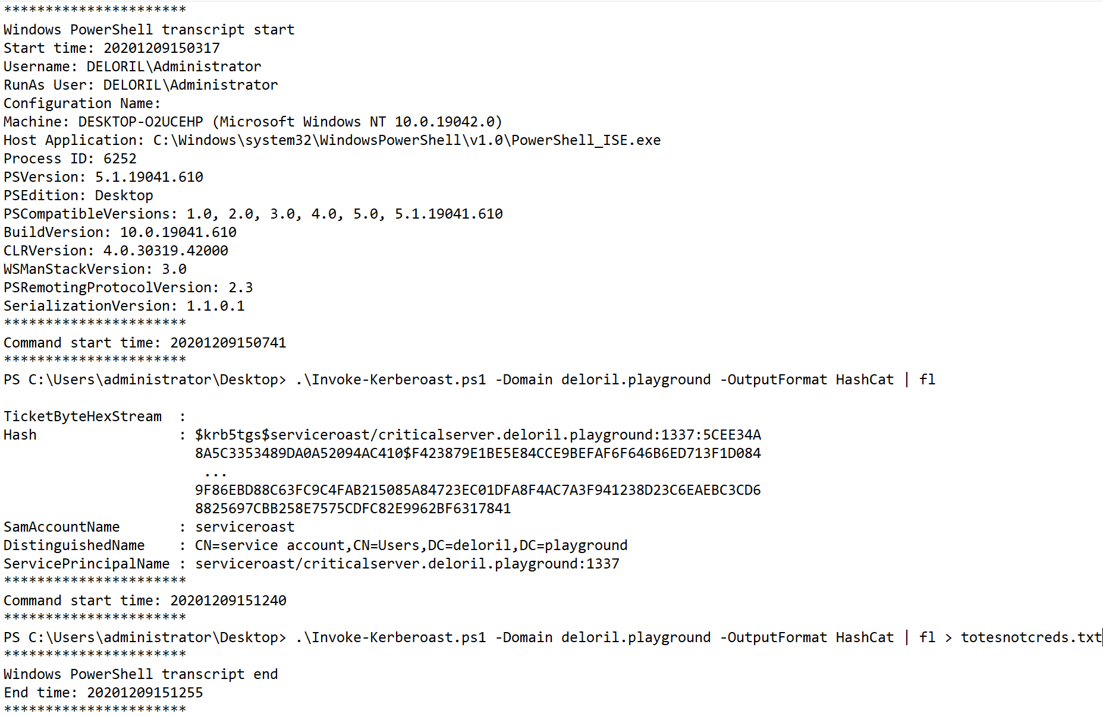
Logging – Powershell:: Transcription

Slide 19
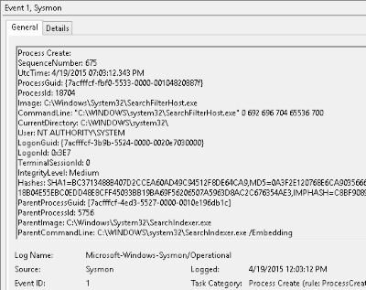
Sysmon
Incident responders wet dream

Slide 20
Domain controller compromise
Runs mimikatz
On a domain controller!
Pack it up boys, we hosed

Slide 21

Service Level Agreements
Formalise MSP requirements
"but they've done right by us before" isn't good enough
Specific to security incident

Slide 22
Application whitelisting

Slide 23
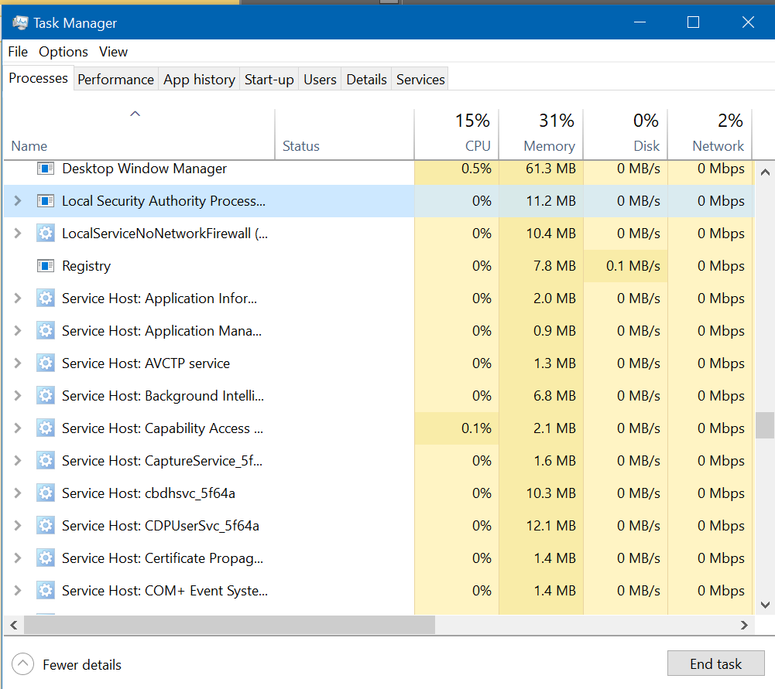
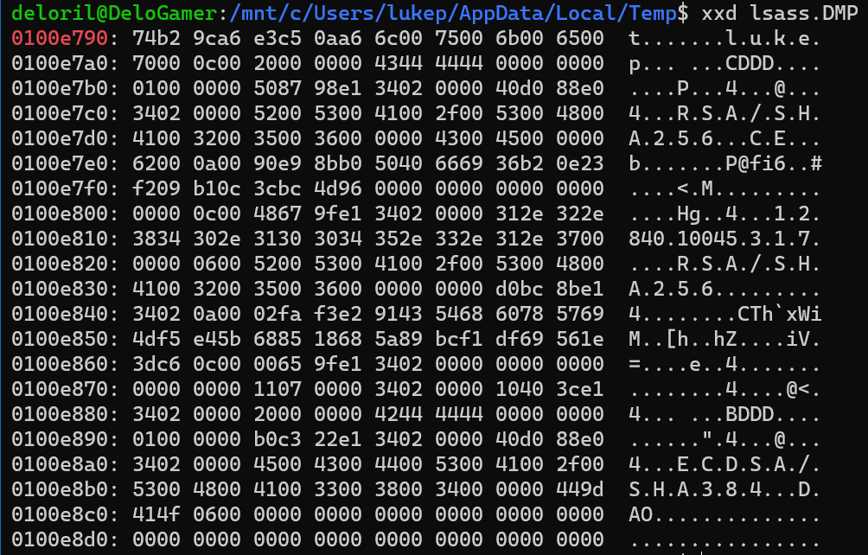
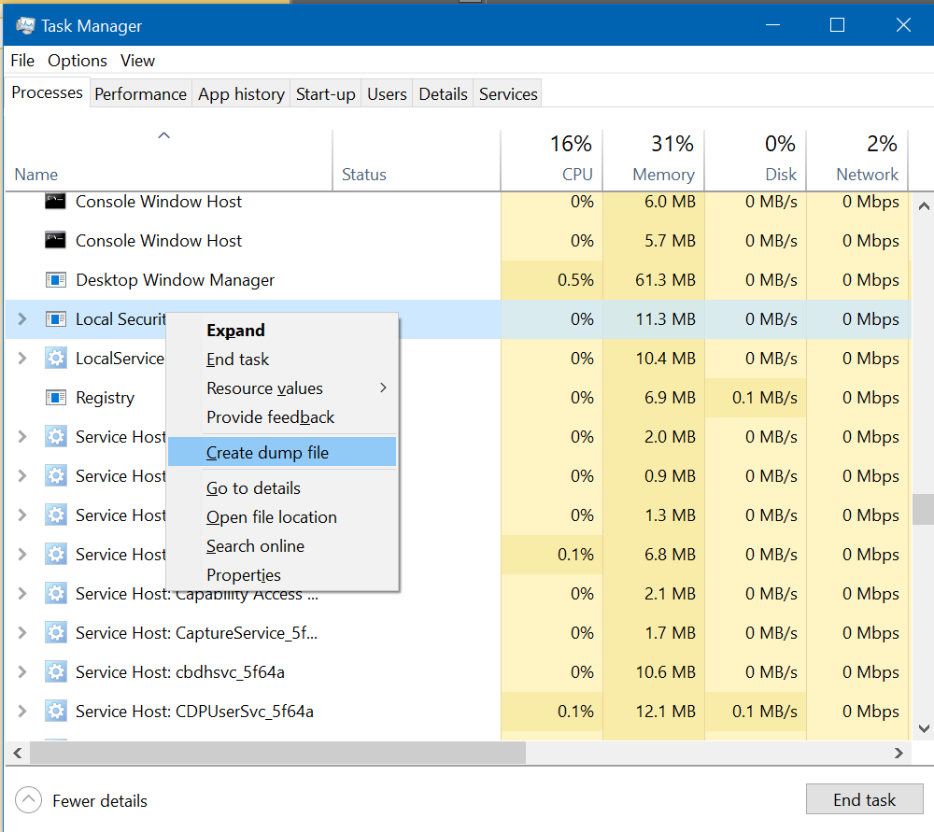
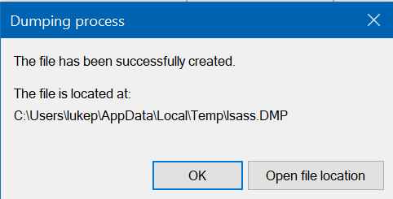
Application Whitelisting

Slide 24
Application Whitelisting Actually useful
It’s too expensive
Doesn't have to be all or nothing
Can be relatively cheap and easy to implement on servers
Increase the noise an attacker makes
Make the attacker move outside their wheelhouse
It’s too complicated
If I can’t manage the workstations, what’s the point

Slide 25
Traversing the firewall
Exploit vulnerability
Insert custom firewall rule
Break through

Slide 26

patching
track release cycles
Create a Standard process
Understand the risks of not patching

Slide 27

Configuration review
permission creep
Expiration on allow rules
Document why rules exist

Slide 28
Extort and ransom
Access the sSN
Steal all of the data
Leave nothing behind

Slide 29

backups
Implement backups
Test your backups
Ensure you have an offline copy of backups

Slide 30
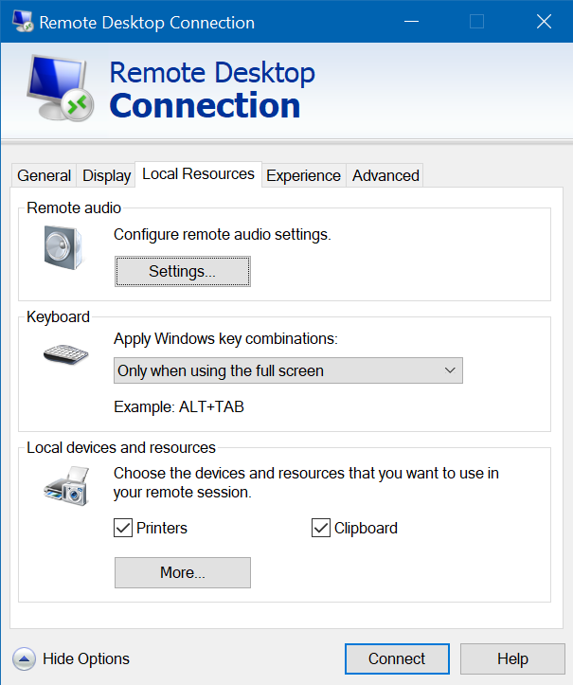
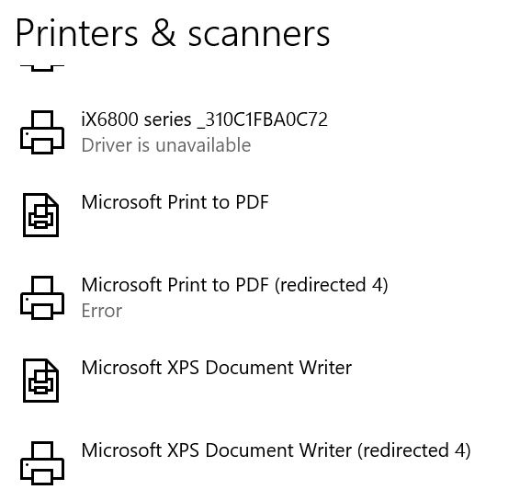
Remember that logging thing?
1111 | Error | Driver Microsoft XPS Document Writer-++-!!DADDY-PC!Microsoft XPS Document Writer-++- required for printer 8 is unknown. Contact the administrator to install the driver before you log in again.

Slide 31
Remediation
Disconnect the internet
Rebuild all the things
Reset all the passwords

Slide 32

Remediation
Disconnect the internet?
Rebuild all the things!
Reset all the passwords!

Slide 33
Remediation woes
A wild internet connection appears
The attacker maintained access
Start again!

Slide 34
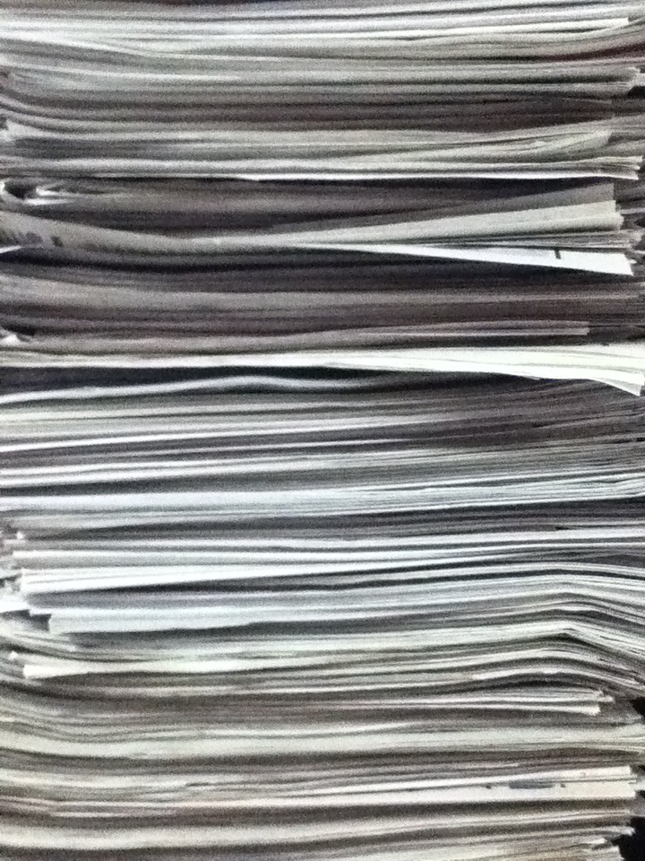
Documentation – as built
Document your networks
Include all interconnects
Include all internet demarks
Include number of endpoints
Endpoint details

Slide 35
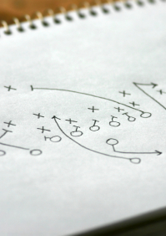
Documentation - playbooks
Plan and document common incident activities
Deploy agents and appliances
Isolating network segments
Isolating individual machines
Blocking traffic to specific IP address
Blocking or sinkholing specific DNS requests
Preventing user access
Actually test them, and keep them up to date

Slide 36

R.I.P
Thus ends the tale of the secrets group
We joke, but serious compromise is the end of Too many companies

Slide 37

education
Community
Formal – security
Formal – not security

Slide 38
https://github.com/Deloril/presentations
Thank you
Questions… Time?
Luke Pearson

